Slide 1

Minimalist Recipe Sharing App
Presented by: SKETCHERS CREW

Slide 2
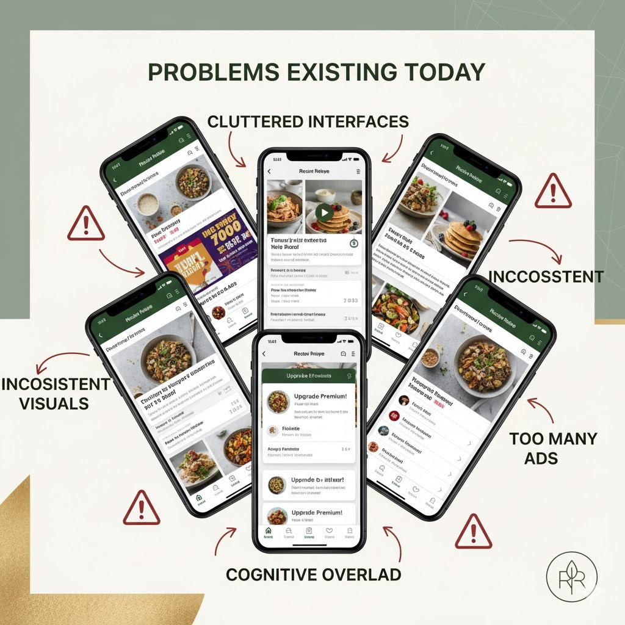
PROBLEMS EXISTING TODAY
1.Cluttered Interfaces
2.Intrusive Ads & Pop-ups
3.Inconsistent Visuals
4.High Cognitive Overload

Slide 3
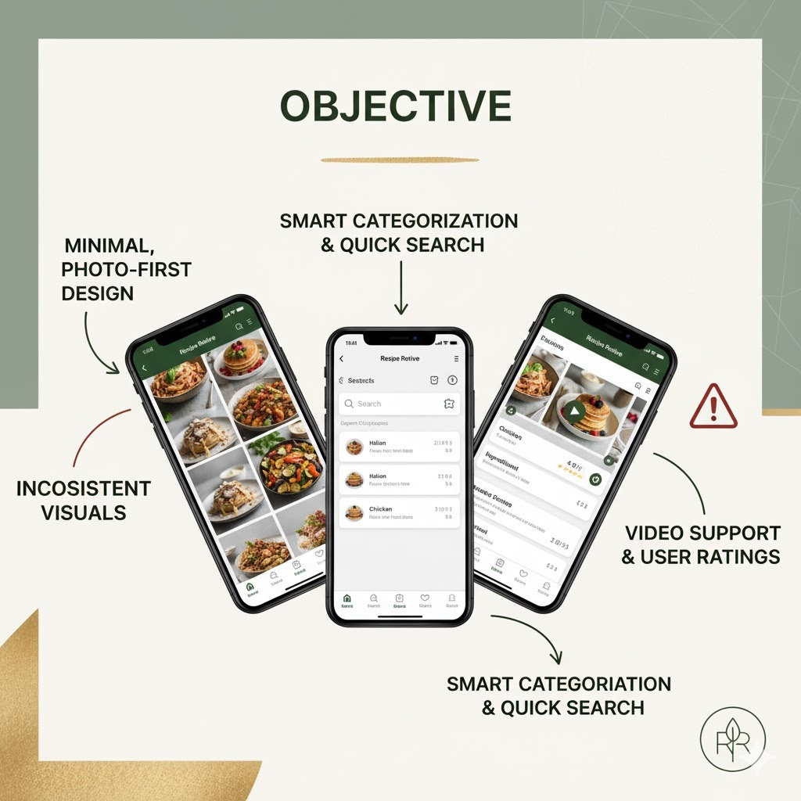
OBJECTIVES
1.Design a minimal, photo-first experience.
2.Build smart, fast search (cuisine, ingredient, skill).
3.Ensure visual consistency.
4.Integrate user ratings and video support.

Slide 4
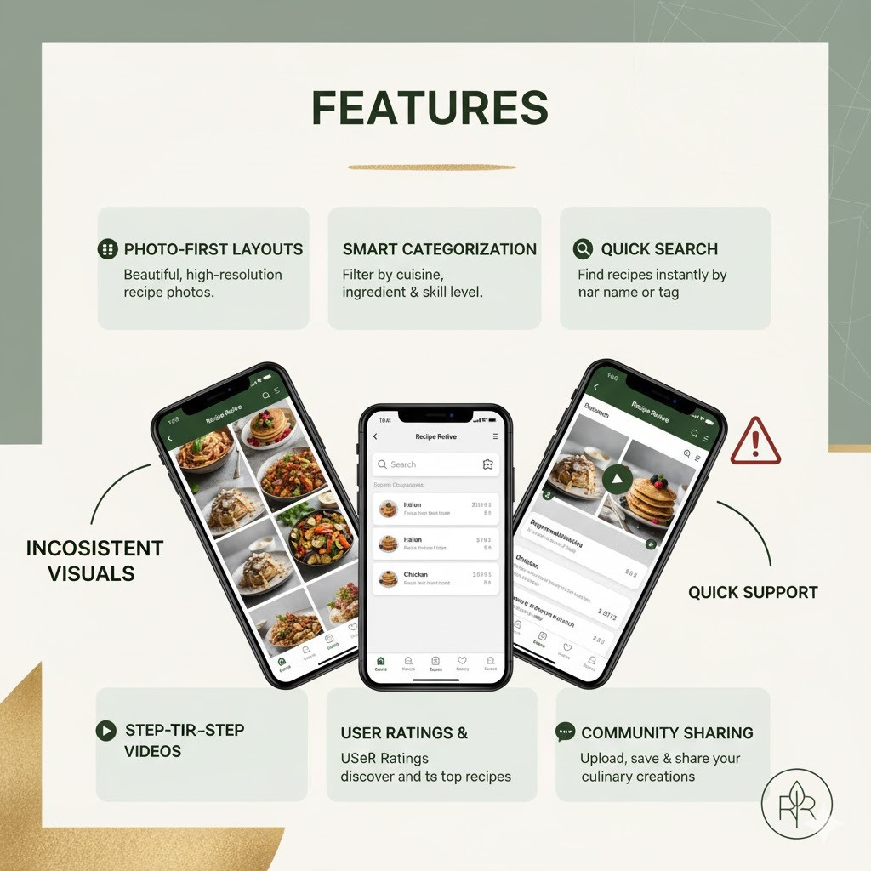
FEATURES
Photo-First Grid Layout
2.Smart Categorization
3.Quick Search
4.Step-by-Step Video Support
5.User Ratings & Reviews
6.Community Uploads

Slide 5
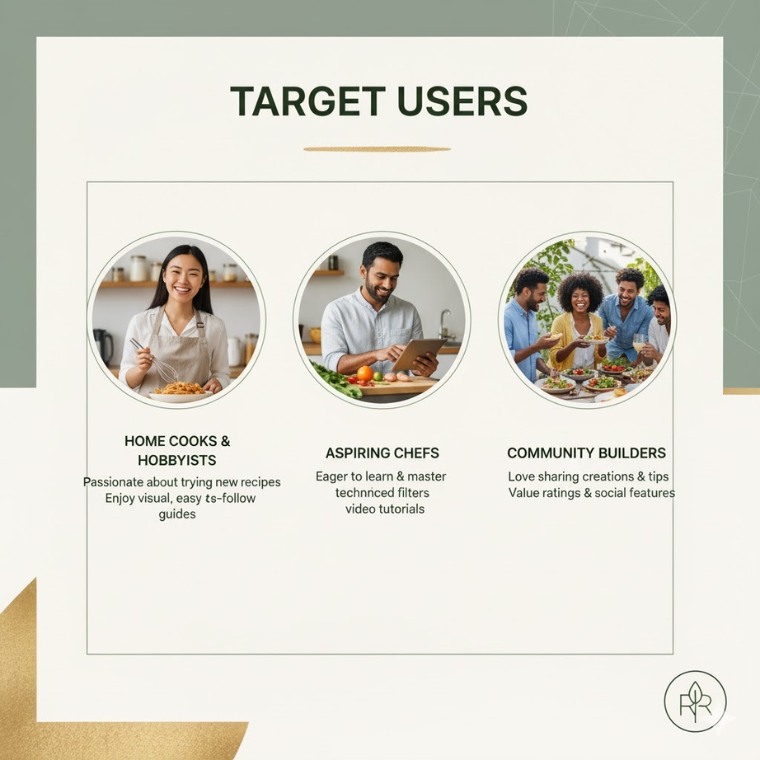
TARGET USERS
1.Home Chefs
2.Beginner Cooks
3.Food Bloggers & Creators
4.Visually-Driven "Foodies"

Slide 6
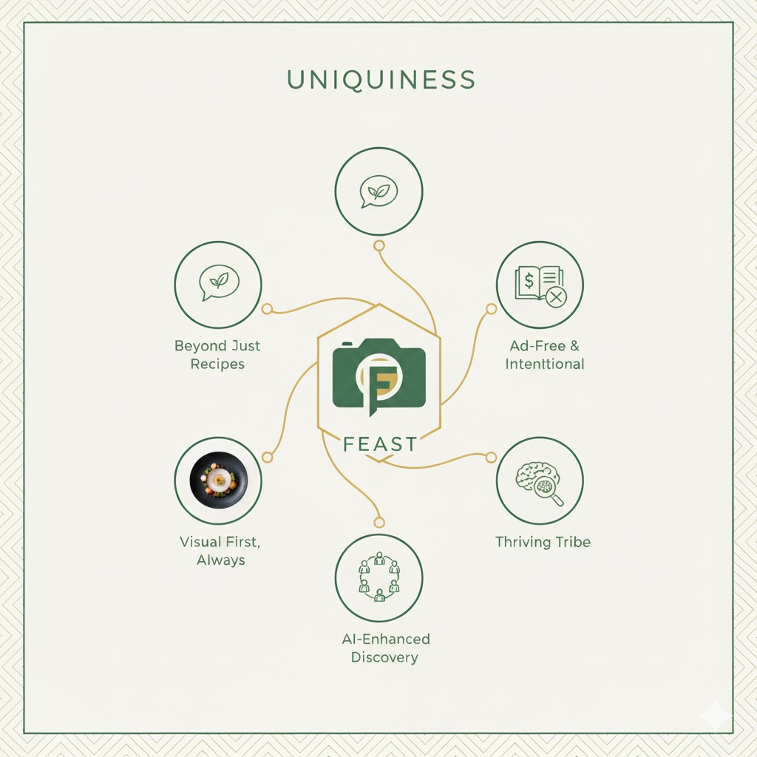
UNIQUENESS
Beyond Just Recipes: More than a database; it's a curated culinary journey.
Ad-Free & Intentional: No distractions, just pure food inspiration.
Visual First, Always: High-quality imagery drives discovery and engagement.
Thriving Tribe: Focus on authentic community sharing, not just content consumption.
AI-Enhanced Discovery: Personalized recommendations truly connect users with flavors they'll love.

Slide 7

DESIGN PRINCIPLES
1.Minimalism & Simplicity
2.Content-First (Photo-Driven)
3.Consistency
4.Intuitive Navigation

Slide 8
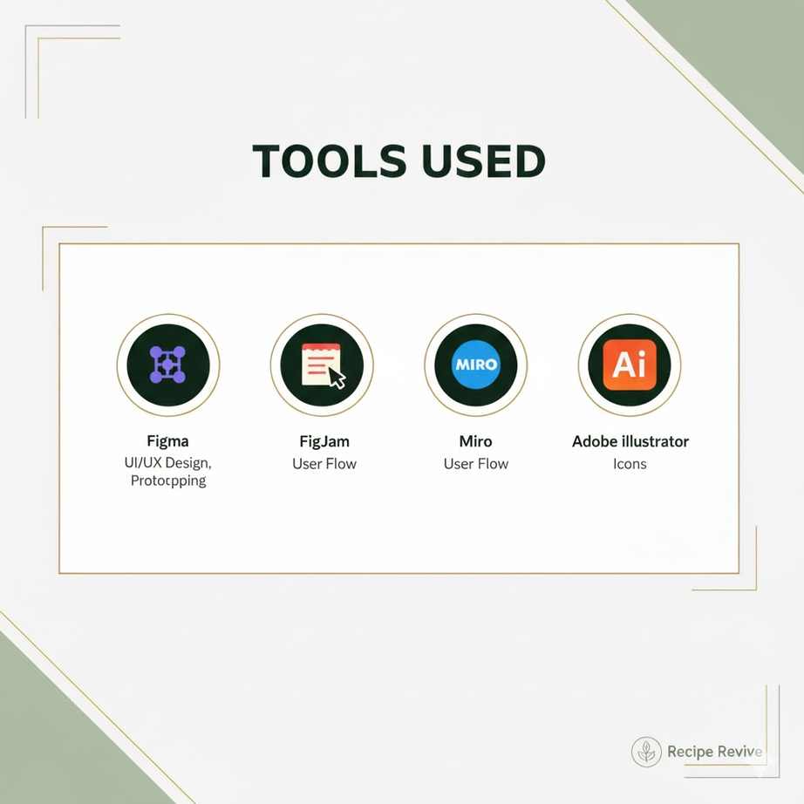
TOOLS USED
1.Design: Figma
2.Prototyping: Figma
3.User Flow: FigJam / Miro
4.Icons: Adobe Illustrator
ADDITIONAL FEATURES

Slide 9
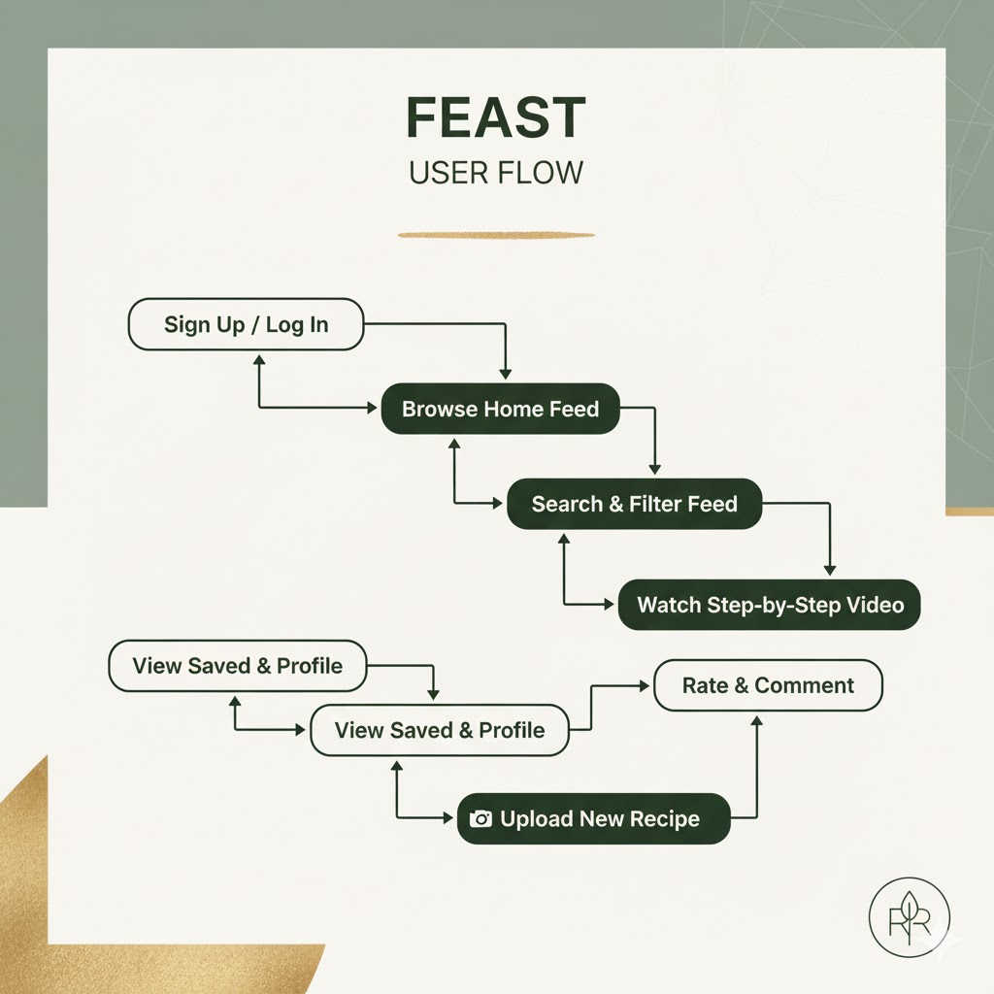
USER FLOW
Start: Open App & Browse Home Feed
Discover: Search by Ingredient or Filter by Cuisine
Engage: Select Recipe, View Steps & Watch Video
Action: Save Recipe to Profile or Share with Community

Slide 10
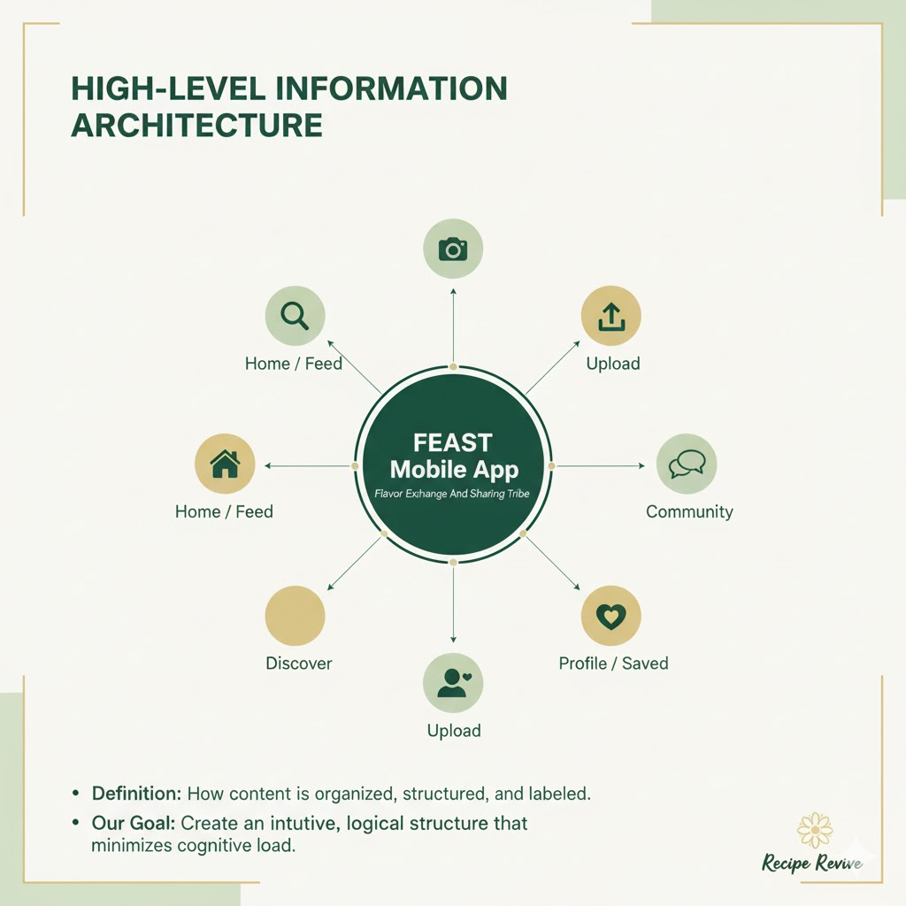
INFORMATION ARCHITECTURE

Slide 11
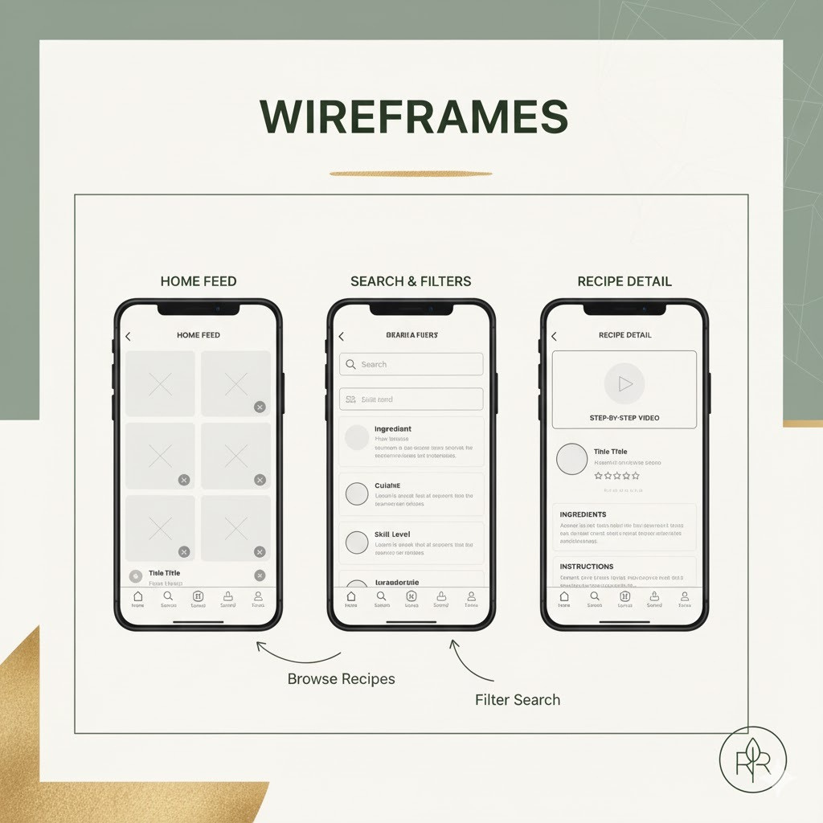
WIREFRAMES

Slide 12
CASE STUDIES
Traditional Recipe Apps (e.g., Allrecipes)
Problem: Cluttered with ads, high cognitive overload, inconsistent UI.
FEAST Solution: Minimal, ad-free design focused purely on content.
Visual Social Platforms (e.g., Pinterest)
Problem: Great for inspiration, but poor for structured search, filtering, and step-by-step instructions.
FEAST Solution: Combines photo-first discovery with powerful, dedicated recipe search and categorization.
Premium Curated Apps (e.g., NYT Cooking)
Problem: Often require paid subscriptions, limiting access and community-generated content.
FEAST Solution: Fosters a free, vibrant community (a "Sharing Tribe") built on user-generated content.
FEAST's unique value is combining visual inspiration, structured functionality, and a thriving community, all in an ad-free, minimal package.

Slide 13
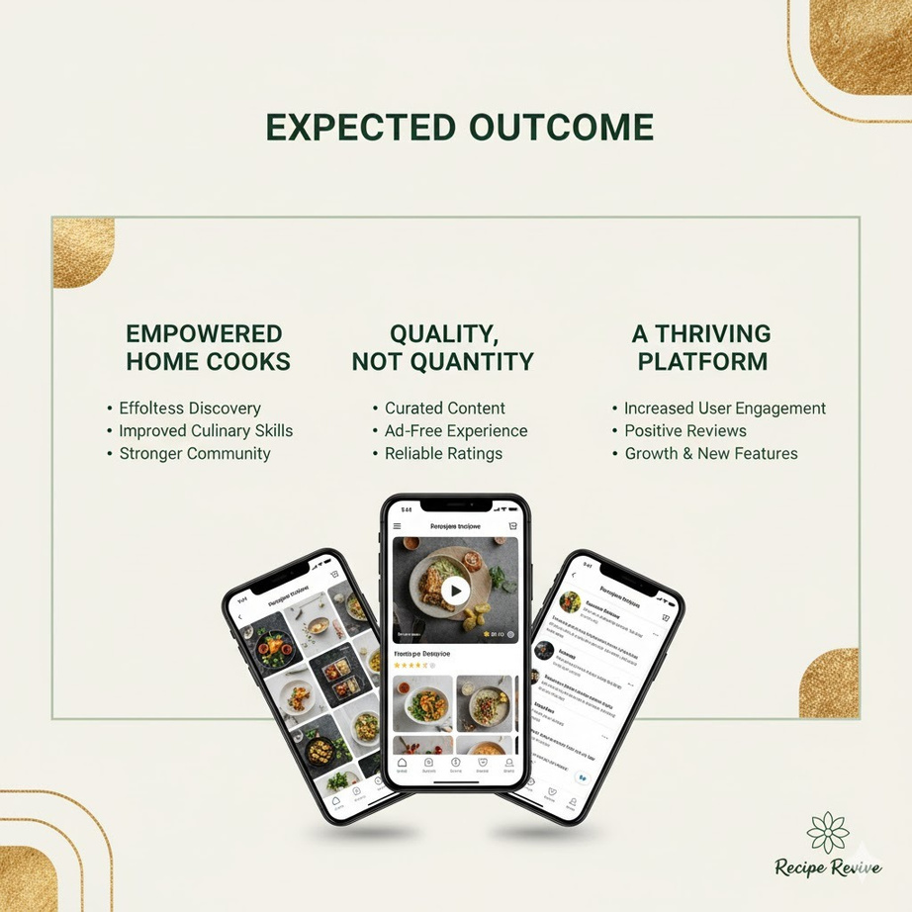
EXPECTED OUTCOME
1.Increased user retention.
2.Reduced user frustration.
3.Growth of an engaged, active community.
4.The go-to app for culinary inspiration.

Slide 14
THANK YOU

